Slide 1
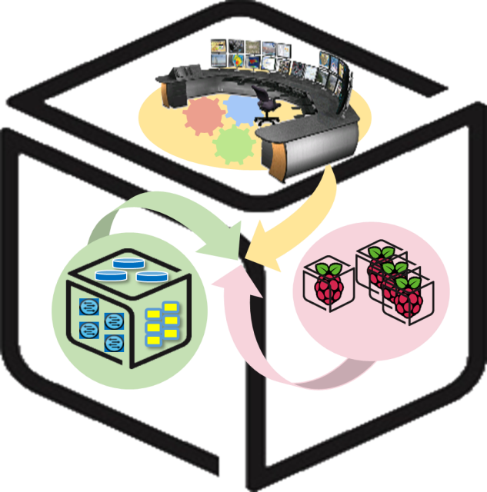


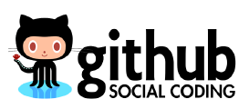
Computer Systems
For AI-inspired Cloud
Theory & Lab.
Lab #5: Cluster
https://github.com/SmartX-Labs/SmartX-Mini-MOOC

Slide 2
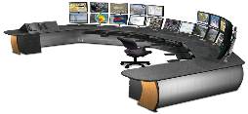


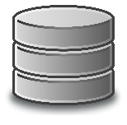



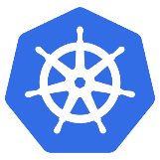
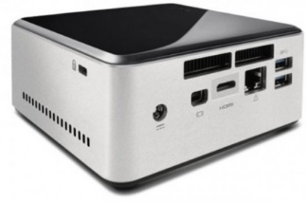
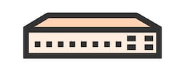
Cluster Lab: Concept
Rook
Rook
Cluster Resource Pool
Kubernetes Master (NUC 1)
Kubernetes Worker 1
(NUC 2)
Switch
Kubernetes Worker 2
(NUC 3)

Slide 3
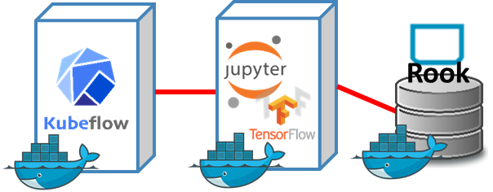
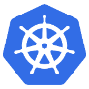
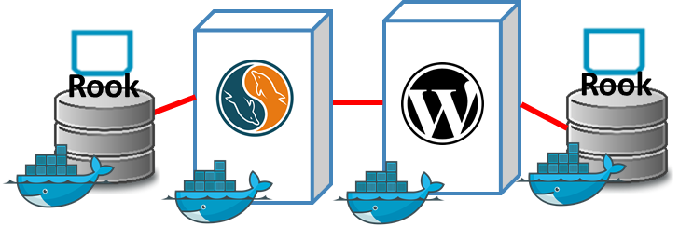
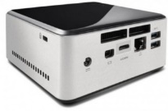


SmartX Labs #1/#5/#6: Relationship
Analytics Lab
(Intelligence Lab)
Cluster Lab
Box Lab

Slide 4



Theory

Slide 5
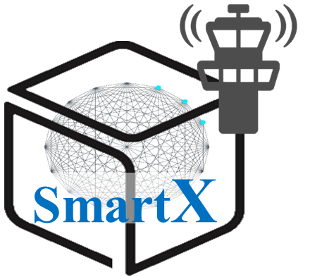


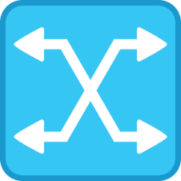
SmartX Cluster: Inter-connected SmartX Boxes
Computing Cluster is a form of computing in which a group of computers are linked together so that they can act like a single entity
Functions
Box
Cluster Resource
Pool
Box
Box
Cluster

Slide 6
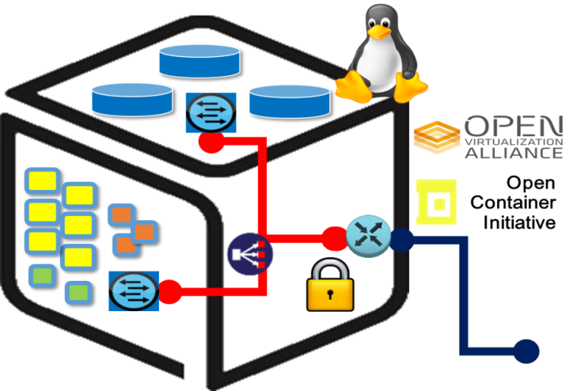
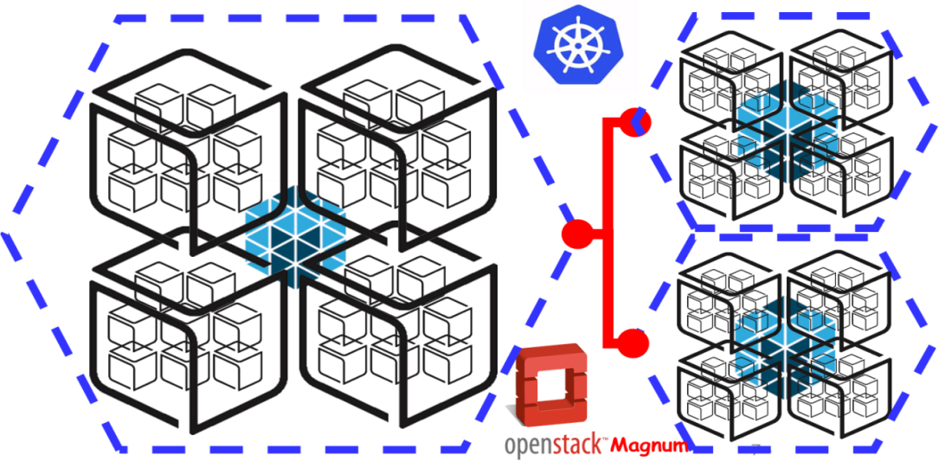
Inter-Connected Functions inside a Box & across Clusters
p+v+c Harmonization Challenge:
p(Baremetal) + v(VM) + c(Container)
Inside a Box
Across Clusters

Slide 7
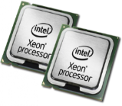

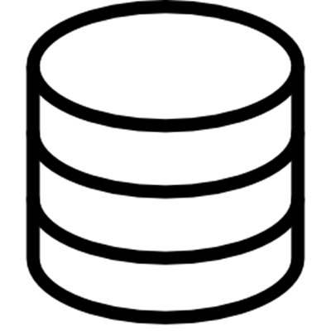
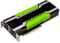




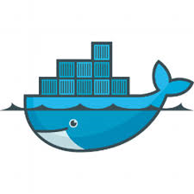
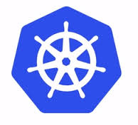




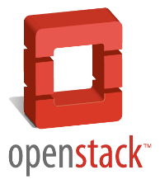
Computer System: Resource Scaling/Pooling with Clustering
NVMe Flash
Scale Out
Scale Up
HBM
Smart NIC
HPC +
HPDA (BigData)
➔ AI (ML/DL)

Slide 8
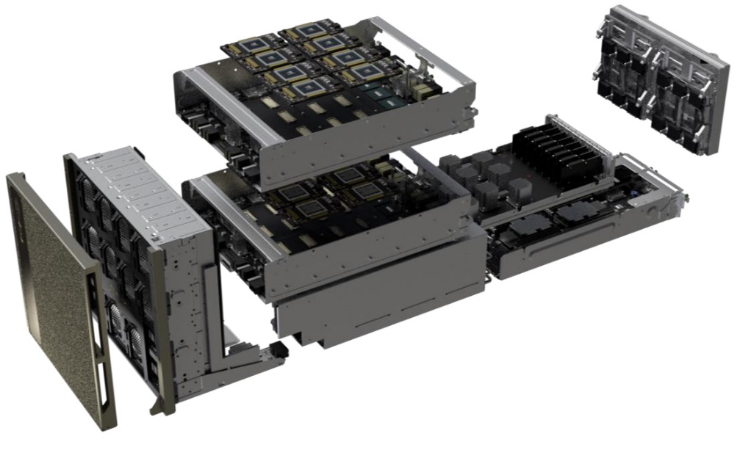




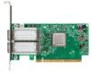

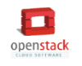
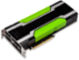


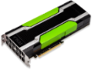

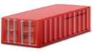

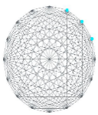






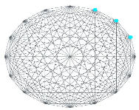
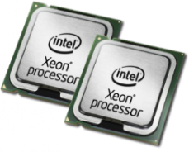

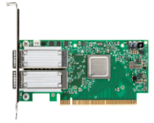
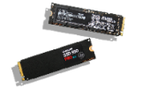

Cluster for AI Computing
HPC + HPDA (BigData)
➔ AI (ML/DL)
Nvidia DGX-2
Intelligence Center
Multi-node AI Computing Cluster with Optimized DL Tools
GPU Acceleration
Container Orchestration
GPU Cards
Cloud Storage Cluster
Parallel File System
Cloud Storage
NVMe SSDs
Smart NICs

Slide 9
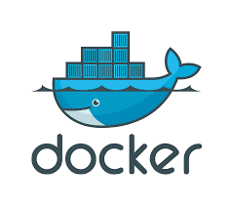
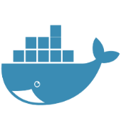
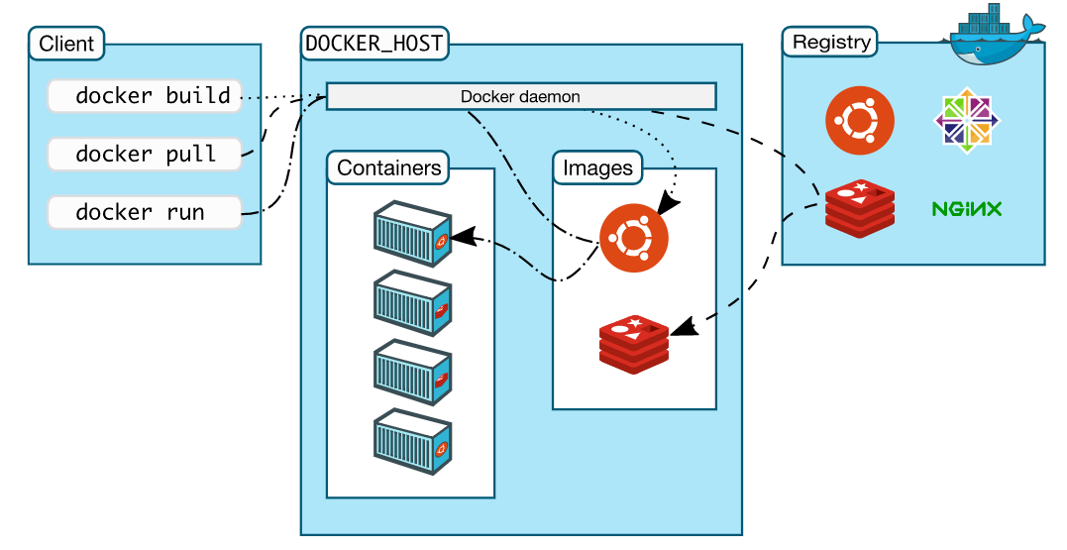
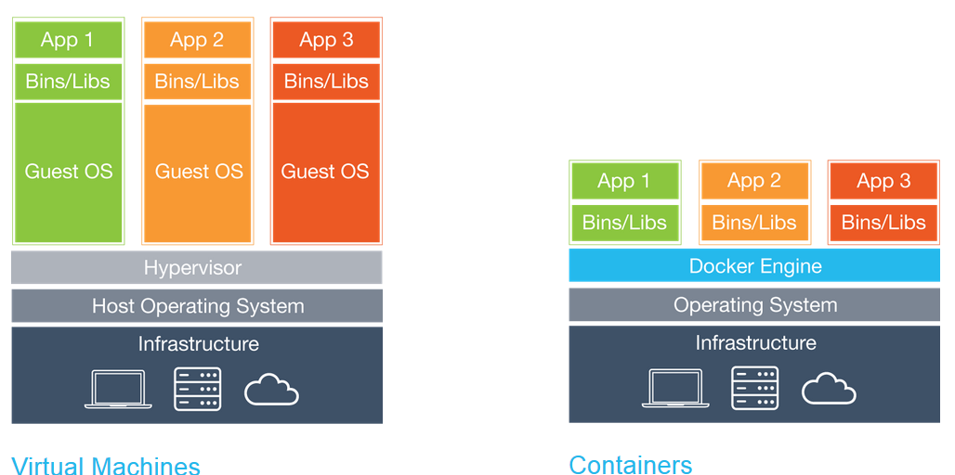
Docker Containers
Docker is an open platform for building, shipping and running distributed applications. It gives programmers, development teams and operations engineers the common toolbox they need to take advantage of the distributed and networked nature of modern applications.
Docker Hub
Since container uses host kernel,
OS of host should be Linux distribution.
https://www.docker.com/

Slide 10
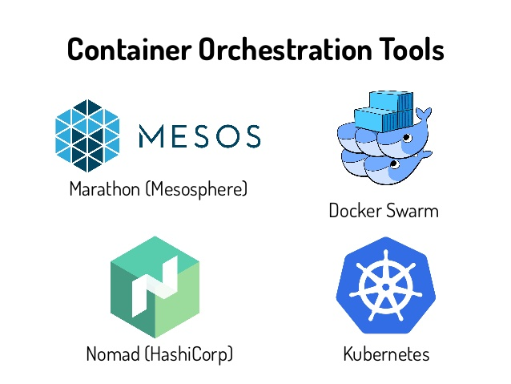
Container Orchestration
Most Popular
Container orchestration refers to the process of organizing the work of individual components and application layers.
Container orchestration engines all allow users to control when containers start and stop, group them into clusters, and coordinate all of the processes that compose an application. Container orchestration tools allow users to guide container deployment and automate updates, health monitoring, and failover procedures.
https://www.hpe.com/us/en/what-is/container-orchestration.html

Slide 11
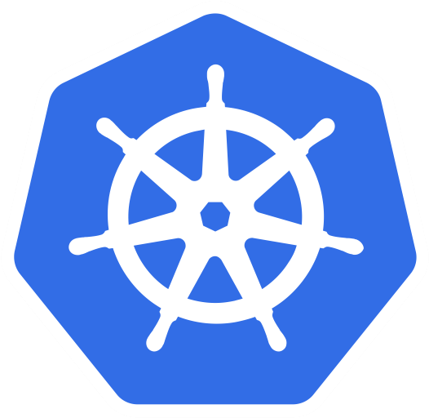
Container Orchestration: Kubernetes
Kubernetes is an open-source system for automating deployment, scaling, and management of containerized applications.
Kubernetes Features
Horizontal scaling: Scale your application up and down with a simple command, with a UI, or automatically based on CPU usage.
Self-healing: Restarts containers that fail, replaces and reschedules containers when nodes die, kills containers that don't respond to your user-defined health check, and doesn't advertise them to clients until they are ready to serve.
Service discovery and load balancing: No need to modify your application to use an unfamiliar service discovery mechanism. Kubernetes gives containers their own IP addresses and a single DNS name for a set of containers, and can load-balance across them.
Storage Orchestration: Automatically mount the storage system of your choice, whether from local storage, a public cloud provider
https://kubernetes.io/

Slide 12
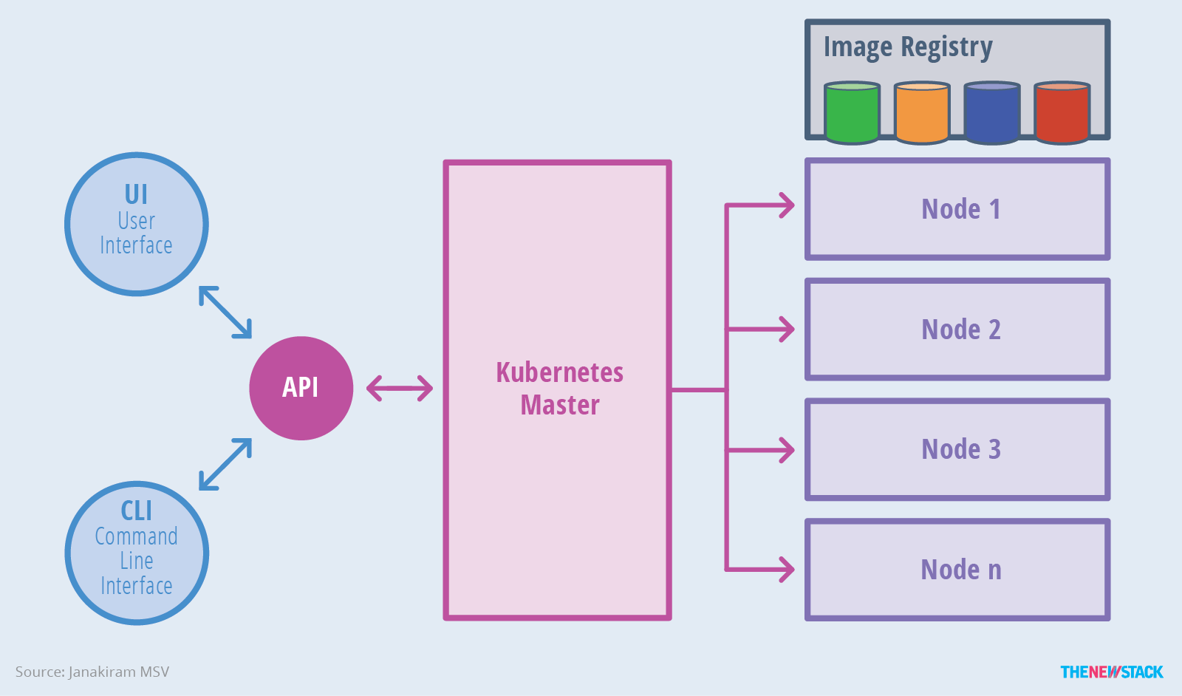
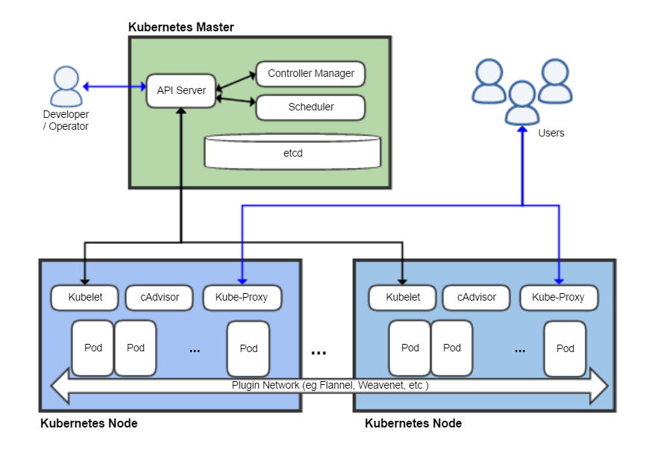
Container Orchestration: Kubernetes
Master
Compute nodes
Kubernetes cluster consists of at least one master and multiple compute nodes.
The master is responsible for exposing the application program interface (API), scheduling the deployments and managing the overall cluster.
Pod is consists of one or more containers that are guaranteed to be co-located on the host machine and can share resources. Each pod is assigned a unique IP address within the cluster, which allows applications to use ports without the risk of conflict.
https://kubernetes.io/

Slide 13

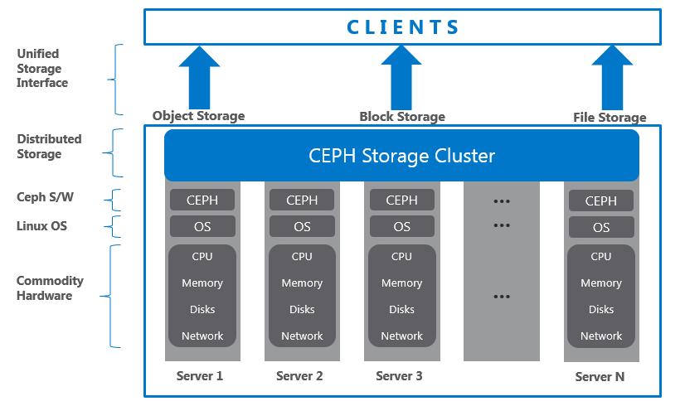
Storage: Ceph and Rook (1/2)
Ceph is a unified, distributed storage system designed for excellent performance, reliability and scalability.
Ceph provide Ceph Object Storage and/or Ceph Block Device services to Cloud Platforms, deploy a Ceph Filesystem or use Ceph for another purpose, all Ceph Storage Cluster deployments begin with setting up each Ceph Node, your network, and the Ceph Storage Cluster.
A Ceph Storage Cluster requires at least one Ceph Monitor, Ceph Manager, and Ceph OSD (Object Storage Daemon). The Ceph Metadata Server is also required when running Ceph Filesystem clients.

Slide 14
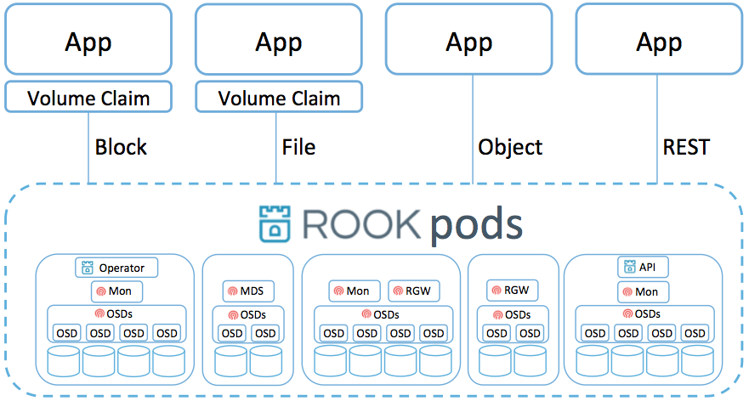
Storage: Ceph and Rook (2/2)
Rook is an open source cloud-native Ceph storage orchestrator for Kubernetes, providing the platform, framework, and support for a diverse set of storage solutions to natively integrate with cloud-native environments.
Rook turns storage software into self-managing, self-scaling, and self-healing storage services. It does this by automating deployment, bootstrapping, configuration, provisioning, scaling, upgrading, migration, disaster recovery, monitoring, and resource management. Rook uses the facilities provided by the underlying cloud-native container management, scheduling and orchestration platform to perform its duties.
https://github.com/rook/rook

Slide 15

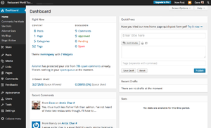
WordPress: Sample Web Application
WordPress is the most popular online Open source publishing platform, currently powering more than 28% of the web. Used by more than 60 million websites,[5] including 30.6% of the top 10 million websites as of April 2018, WordPress is the most popular website management system in use.
You can start a blog or build a website in seconds without any technical knowledge!
https://wordpress.com/

Slide 16
Practice

Slide 17
Cluster Lab: Concept
You
Rook
Rook
Cluster Resource Pool
Kubernetes Master (NUC 1)
Kubernetes Worker 1
(NUC 2)
Switch
Kubernetes Worker 2
(NUC 3)

Slide 18
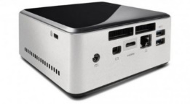

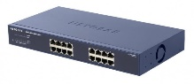
NAME: NUC5i5MYHE (NUC PC) CPU: i5-5300U @2.30GHz CORE: 4 Memory: 16GB DDR3 HDD: 94GB
#0 - Lab Preparation (1/4)
Wired connection
NAME: netgear prosafe 16 port gigabit switch(Switch) Network Ports: 16 auto-sensing 10/100/1000 Mbps Ethernet ports

Slide 19
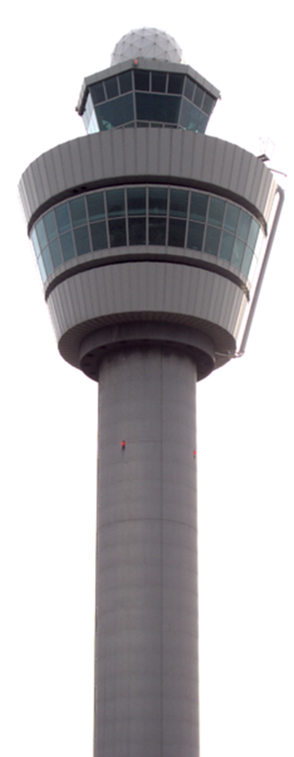
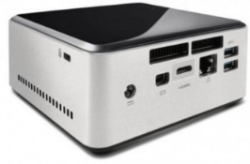

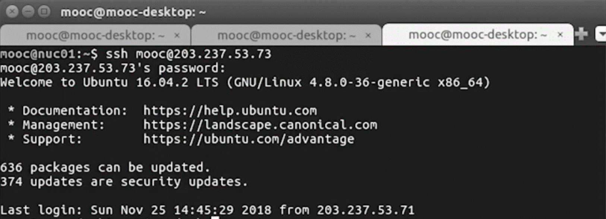
#0 - Lab Preparation (2/4)
- Boxes preparation: interconnect NUCs
For NUC1
In new terminal
$ ssh <nuc2 name>@<nuc2 IP address>
> <nuc2 name>@<nuc2 IP address>’s password : <nuc2 pw>
In another new terminal
$ ssh <nuc3 name>@<nuc3 IP address>
> <nuc3 name>@<nuc3 IP address>’s password : <nuc3 pw>
NUC1 terminal
NUC2 terminal
NUC3 terminal
In NUC1

Slide 20
#0 - Lab Preparation (3/4)
- Boxes preparation: configure hostname
From NUC 1 :
sudo hostname nuc01
From NUC 2 :
sudo hostname nuc02
From NUC 3 :
sudo hostname nuc03
Edit /etc/hosts from all NUCs :
sudo vi /etc/hosts
Append the following context into /etc/hosts :
127.0.0.1 localhost
IP Address of NUC 1 nuc01
IP Address of NUC 2 nuc02
IP Address of NUC 3 nuc03

Slide 21



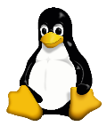

#0 - Lab Preparation (4/4)
Boxes preparation:
Check full network connectivity between all boxes
$ ping nuc02
$ ping nuc03
NUC 1
$ ping nuc01
$ ping nuc03
$ ping nuc01
$ ping nuc02
NUC 2
NUC 3

Slide 22
#1-1 Preparations for Clustering:
Prerequisites Installation
For All NUCs
A prerequisite for kubernetes: Docker Installation.(Based on Docker Documentation)
// Set up the repository:
// Install packages to allow apt to use a repository over HTTPS
$ sudo apt-get update
$ sudo apt-get install -y ca-certificates curl gnupg lsb-release
// Add Docker's official GPG key:
$ curl -fsSL https://download.docker.com/linux/ubuntu/gpg | sudo gpg --dearmor -o /usr/share/keyrings/docker-archive-keyring.gpg
// Add the Docker apt repository:
$ echo \
"deb [arch=$(dpkg --print-architecture) signed-by=/usr/share/keyrings/docker-archive-keyring.gpg] https://download.docker.com/linux/ubuntu \
$(lsb_release -cs) stable" | sudo tee /etc/apt/sources.list.d/docker.list > /dev/null
// Install Docker CE
$ sudo apt-get update
$ sudo apt-get install docker-ce docker-ce-cli containerd.io

Slide 23
#1-1 Preparations for Clustering:
Prerequisites Installation
For All NUCs
A prerequisite for kubernetes: Docker Installation.(Based on Docker Documentation)
//continued
// Set up the Docker daemon
$ cat <<EOF | sudo tee /etc/docker/daemon.json
{
"exec-opts": ["native.cgroupdriver=systemd"],
"log-driver": "json-file",
"log-opts": {
"max-size": "100m"
},
"storage-driver": "overlay2"
}
EOF
// Create /etc/systemd/system/docker.service.d
$ sudo mkdir -p /etc/systemd/system/docker.service.d
$ sudo systemctl daemon-reload
$ sudo systemctl enable docker
$ sudo systemctl restart docker
$ sudo systemctl restart docker.socket

Slide 24
#1-1 Preparations for Clustering:
Prerequisites Installation
For All NUCs
A prerequisite for ROOK : xfsprogs installation
$ sudo apt-get install xfsprogs

Slide 25
#1-2 Preparations for Clustering:
Kubernetes Installation
Kubernetes Master (NUC01)
Kubernetes Worker 1
(NUC02)
Kubernetes Worker 2
(NUC03)
We will deploy kubernetes on All NUCs and configure as above

Slide 26
#1-2 Preparations for Clustering:
Kubernetes Installation
For All NUCs
$ sudo su
# apt-get update && apt-get install -y apt-transport-https curl ipvsadm wget
# curl -s https://packages.cloud.google.com/apt/doc/apt-key.gpg | apt-key add -
# cat <<EOF | tee /etc/apt/sources.list.d/kubernetes.list
> deb http://apt.kubernetes.io/ kubernetes-xenial main
> EOF
# curl -s https://packages.cloud.google.com/apt/doc/apt-key.gpg | sudo apt-key add -
$ apt-get update
$ apt-get install -y --allow-downgrades kubelet=1.14.1-00 kubeadm=1.14.1-00 \
> kubectl=1.14.1-00 kubernetes-cni=0.7.5-00
$ exit
Disable root permissions
Notes:
수정된 부분 : allowing downgrades를 추가함, kubernetes-cni도 추가

Slide 27
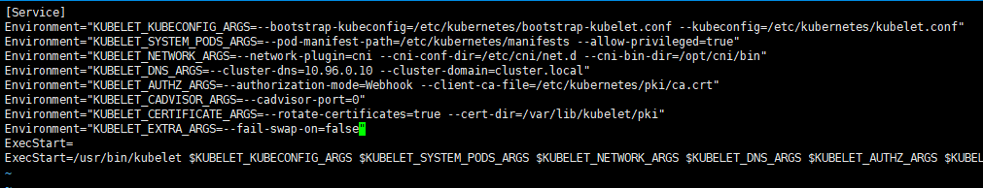
#1-3 Preparations for Clustering:
Kubernetes Configuration
For All NUCs
If swap is not disabled, kubelet service will not start on the masters and nodes. First, you need to edit kubernetes configure file
$ sudo vi /etc/systemd/system/kubelet.service.d/10-kubeadm.conf
Add [ Environment="KUBELET_EXTRA_ARGS=--fail-swap-on=false" ]
$ sudo systemctl daemon-reload
$ sudo systemctl restart kubelet
Add the line like this
For All NUCs
Run the following command to disable swap immediately.
$ sudo swapoff -a
$ sudo sed -e '/\/swapfile/s/^/#/g' -i /etc/fstab
$ sudo sed -e '/\/swap\.img/s/^/#/g' -i /etc/fstab

Slide 28
#2-1 Clustering:
Running Kubernetes Master
For NUC1
$ sudo systemctl daemon-reload
$ sudo systemctl restart kubelet
$ sudo kubeadm reset -f
$ sudo rm -rf /etc/cni/net.d
$ sudo ipvsadm --clear
$ sudo rm -rf /var/lib/rook
$ sudo kubeadm init --ignore-preflight-errors=all
You need to copy the command for joining kubernetes nodes (NUC2, NUC3)
Please copy it!
Notes:
#2-1 수정 슬라이드

Slide 29
#2-1 Clustering:
Running Kubernetes Master
For NUC1
Run these commands to make kubectl work for your non-root user.
When you run these commands, make sure that you are not in root
$ mkdir -p $HOME/.kube
$ sudo cp -i /etc/kubernetes/admin.conf $HOME/.kube/config
$ sudo chown $(id -u):$(id -g) $HOME/.kube/config
$ kubectl taint nodes --all node-role.kubernetes.io/master-
Notes:
#2-1 수정 슬라이드

Slide 30


#2-2 Clustering:
Joining k8s nodes to k8s master
You can join NUC2, NUC3 to k8s master(NUC1) by following commands
For NUC2, NUC3
$ sudo systemctl daemon-reload
$ sudo systemctl restart kubelet
$ sudo kubeadm reset -f
$ sudo rm -r /etc/cni/net.d
$ sudo ipvsadm --clear
$ sudo rm -rf /var/lib/rook
$ sudo kubeadm join NUC1 IP:6443 --token YOUR TOKEN --discovery-token-ca-cert-hash YOUR HASH --ignore-preflight-errors=all → Paste the command you just copied
If ipvsadm is not installed,
$ sudo apt-get install ipvsadm
Check all nodes are joined
For NUC1
$ kubectl get node
Notes:
#2-2 수정 슬라이드. 일부 커맨드 추가 및 ipvsadm 설치 추가

Slide 31


#2-3 Clustering:
k8s Network Plugin Installation
You MUST install a pod network add-on so that your pods can communicate with each other. We will use Weave in this lab.
Install Weave (pod network add-on)
For NUC1
$ kubectl apply -f "https://cloud.weave.works/k8s/net?k8s-version=$(kubectl version | base64 | tr -d '\n')"
For NUC1
Make sure Weave(network add-on) works
$ kubectl get nodes
$ kubectl get po -n kube-system -o wide

Slide 32
#2-3 Clustering:
ROOK Installation
For NUC1
Set Privileges on cluster for ROOK
$ kubectl create clusterrolebinding permissive-binding \
--clusterrole=cluster-admin \
--user=admin \
--user=kubelet \
--group=system:serviceaccounts
For NUC1
Install ROOK Storage on your cluster
$ cd $HOME
$ git clone --single-branch --branch release-1.2 https://github.com/rook/rook.git
$ cd $HOME/rook/cluster/examples/kubernetes/ceph
$ kubectl create -f common.yaml
$ kubectl create -f operator.yaml
$ kubectl create -f cluster-test.yaml
Notes:
#2-3 수정 슬라이드

Slide 33

#2-3 Clustering:
ROOK Installation
For NUC1
Check rook-ceph-pod
$ watch kubectl get pod -n rook-ceph
For NUC1
Install ToolBox and Execute ToolBox
$ cd $HOME/rook/cluster/examples/kubernetes/ceph
$ kubectl create -f toolbox.yaml
$ kubectl -n rook-ceph rollout status deploy/rook-ceph-tools
$ kubectl -n rook-ceph exec -it $(kubectl -n rook-ceph get pod -l “app=rook-ceph-tools”
-o jsonpath=‘{.items[0].metadata.name}’) bash
<in the toolbox>
$ watch ceph status
$ exit
For NUC1
Add StorageClass
$ kubectl apply -f csi/rbd/storageclass-test.yaml
Notes:
#2-3 수정 슬라이드
Toolbox 실행 부분이 안됩니다!

Slide 34


#2-4 Cluster Validation:
Deploy Sample Web application
Rook
Rook
Persistent volume
Persistent volume
For NUC1
Deploy a Sample Web Application (WordPress) on your cluster.
$ kubectl create -f $HOME/rook/cluster/examples/kubernetes/mysql.yaml
$ kubectl create -f $HOME/rook/cluster/examples/kubernetes/wordpress.yaml
For NUC1
Check Wordpress containers are started
$ watch kubectl get pod
Notes:
#2-4 수정 슬라이드

Slide 35



#2-4 Cluster Validation:
Deploy Sample Web application
For NUC1
Check exposed port for Wordpress service.
The address of your Wordpress Web is http://your NUC1 IP: exposed port
$ kubectl get svc
exposed port
Enter this address in your web browser:
http://your NUC1 IP:exposed port

Slide 36
Review

Slide 37
Lab Summary
With Cluster Lab, you have experimented
How to physically connect multiple NUCs with a switch to create the targeted physical cluster?
How to install (deploy) and configure container-orchestrated software functions to enable the desired cluster role (e.g., HPC, HPDA, ML/DL, …)
Understanding how container orchestration is working: Can you distinguish Kubernetes master from Kubernetes nodes?

Slide 38

Thank You for Your Attention
Any Questions?
mini@smartx.kr

